Slide 1
Comeniusproject - Sustainability Flanders
Blerta Kamberi & Kelly Looghe

Slide 2
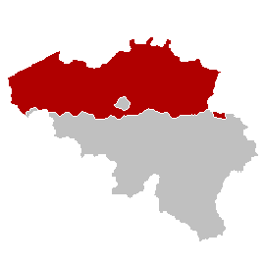
Flanders GENERAL
federal state of Belgium;
one of the most prosperous and crowded areas in Europe
capital: Brussels

Slide 3
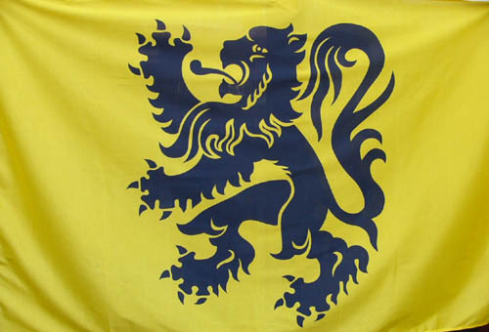
The flag of flanders: The Flemish LION

Slide 4
location

Slide 5
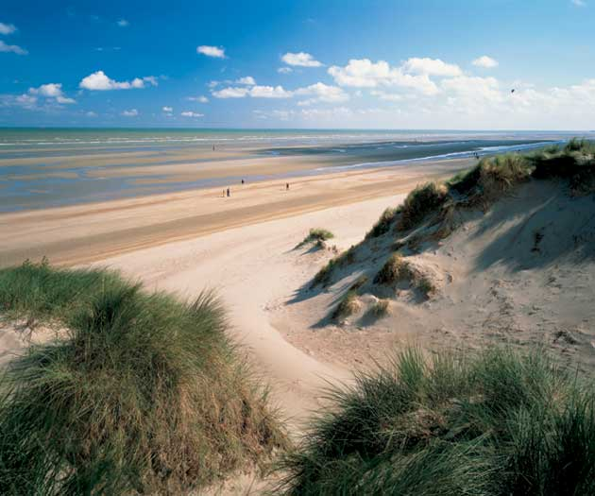
Geography I
Big cities: Brussels, Antwerp, Ghent, Bruges, Leuven, Sint-Niklaas…
Urban heartland: Flemish rhomb
The Belgian coastline: 66 km
Highest point: Remersdaal: 287,5 m

Slide 6
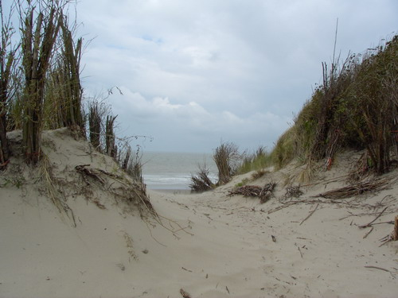
GEOGRAPHY II
Climate (two types):
→ maritime climate at the coast
→ maritime sea climate in middle Flanders
Landscape:
→ coast: beach and dune strips
→ Kempen: heath and pine forests
Important rivers:
Schelde, Maas, IJzer

Slide 7
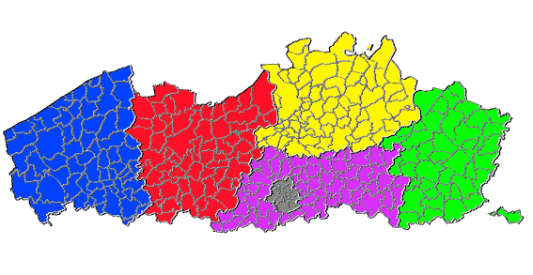
Flemish Provinces
West Flanders
East Flanders
Antwerp
Flemish Brabant
Limburg

Slide 8
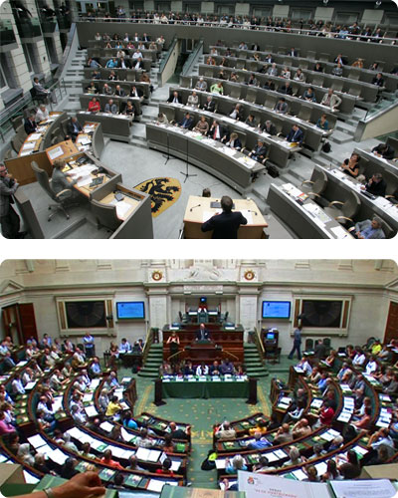
politics
Flemish parliament:
- Elections: each 5 years
- 124 flemish representatives
Flemish gouvernment:
Political Parties

Slide 9
THE End
Thank you for your attention!

