Slide 1
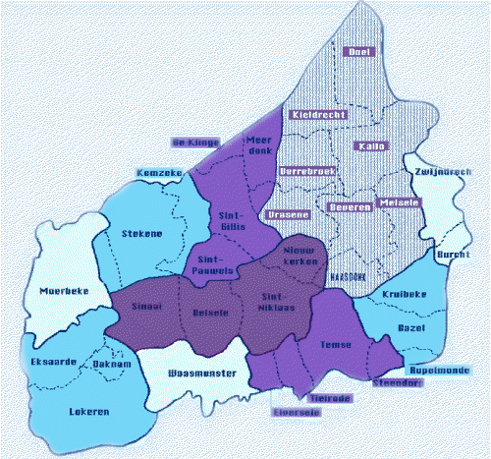
WAASLAND Land Van Waas

Slide 2
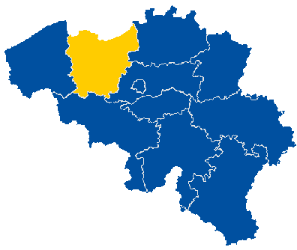
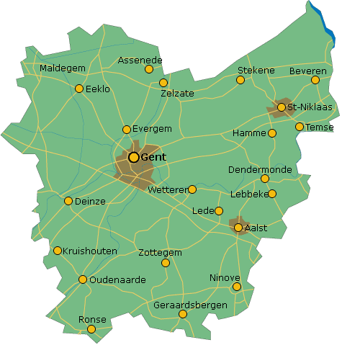
A historical and geographical region
Was part of t he County Flanders
It is situated in East-Flanders
The borders : North = Holland East = Schelde (river) South = Schelde & Durme West = Durme (river)

Slide 3
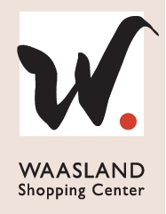
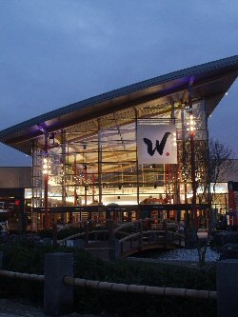
Waasland Shopping Center
It is the biggest one floor shopping center
of the Benelux. That stands for Belgium, Netherlands and Luxemburg.
There are 140 stores.
It is situated in the centre of Sint-Niklaas.

Slide 4
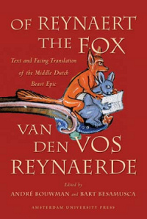
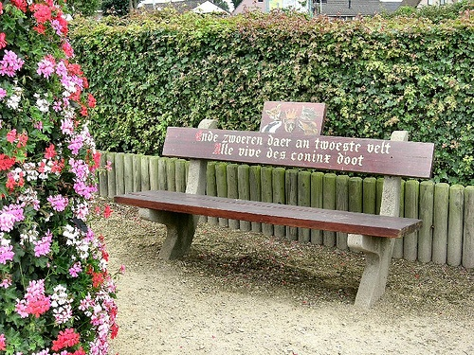
Van Den Vos Reynaerde
The writer of the famous, medieval animal epic Reynaert The Fox, Willem die Madoc maecte, worked as a monk in an Abbey in Klein-Sinaai, here in Waasland.
The story also is situated in the Waasland, thats why Reynaert The Fox is always linked with Waasland.
There are also many sculptures and benches all over Waasland. As you can see on the picture.

Slide 5
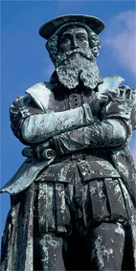
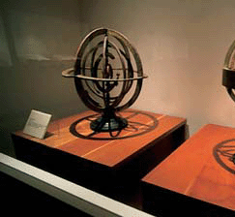
Mercator
Gerardus Mercator is a world famous cartographer. He almost won the contest of the biggest Belgian. And that’s no wonder if you know that he has done very important work.
He was born in Rupelmonde, one of the villages of Waasland. There you find innumerable references to his job and life.
The Mercatormuseum of Sint-Niklaas offers you a chance to learn more about cartography in a scientific way. You can see some of his masterworks like globes and atlases.

Slide 6
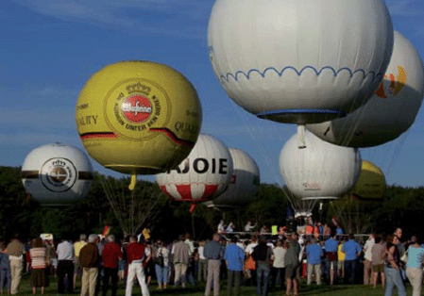
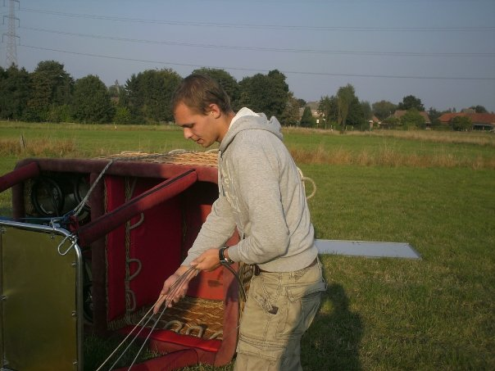
Ballonvaart
One fifth of the balloonists in Belgium live in Waasland. We have one of those balloonists here, Frédéric. They turn the sky into one spectacle of colours and movements.

Slide 7
Thank you for your attention!
The END

